Slide 1
Localization Using Landmarks
Chapter 8

Slide 2
Revisiting the Localization via Landmarks
recall that on Day 22 we used an extended Kalman filter to estimate the position and orientation of mobile robot moving in the plane
  we assumed that the robot could measure the distance to beacons (landmarks) with known locations in the world
today we revisit the localization problem via landmarks and look at some classical solutions to the problem

Slide 3
Landmarks
a landmark is literally a prominent geographic feature of the landscape that marks a known location
in common usage, landmarks now include any fixed easily recognizable objects
  e.g., buildings, street intersections, monuments
for mobile robots, a landmark is any fixed object that can be sensed

Slide 4
Landmarks for Mobile Robots
visual
  artificial or natural
retro-reflective
beacons
  LORAN (Long Range Navigation): terrestrial radio; now being phased out
  GPS: satellite radio
acoustic
scent?

Slide 5
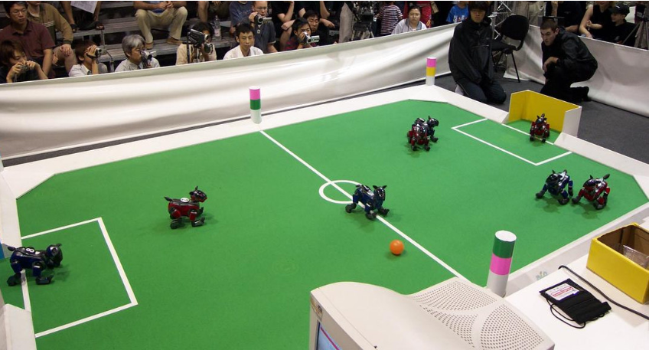
Landmarks: RoboSoccer

Slide 6
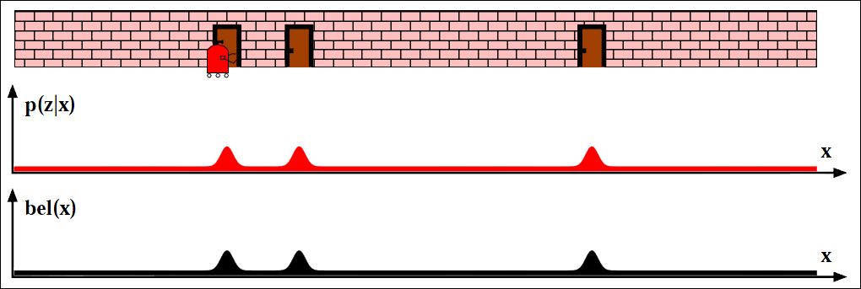
Landmarks: Corridor Environments

Slide 7
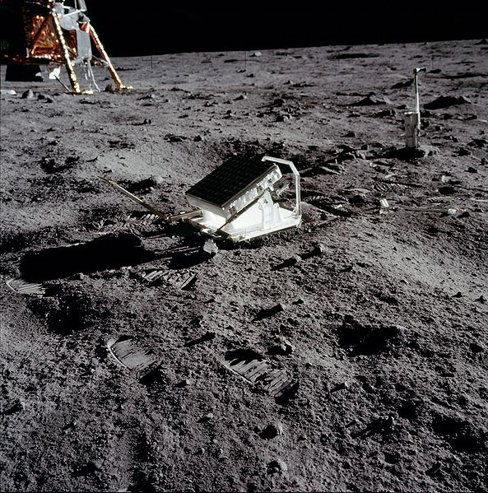
Landmarks: Retroreflector

Slide 8
Trilateration
uses distance measurements to two or more landmarks
suppose a robot measures the distance d₁ to a landmark
  the robot can be anywhere on a circle of radius d₁ around the landmark
d₁
landmark

Slide 9
Trilateration
without moving, suppose the robot measures the distance d₂ to a second landmark
  the robot can be anywhere on a circle of radius d₂ around the second landmark
d₁
d₂
landmark
landmark

Slide 10
Trilateration
the robot must be located at one of the two intersection points of the circles
  tie can be broken if other information is known
d₁
d₂
landmark
landmark

Slide 11
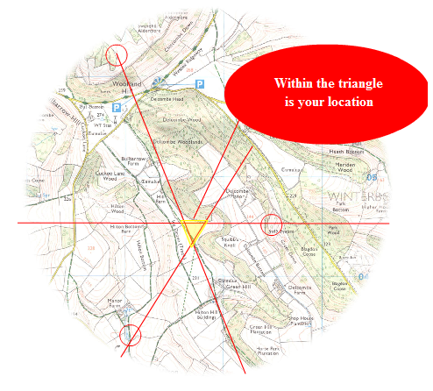
Triangulation
triangulation uses angular information to infer position
  http://longhamscouts.org.uk/content/view/52/38/

Slide 12
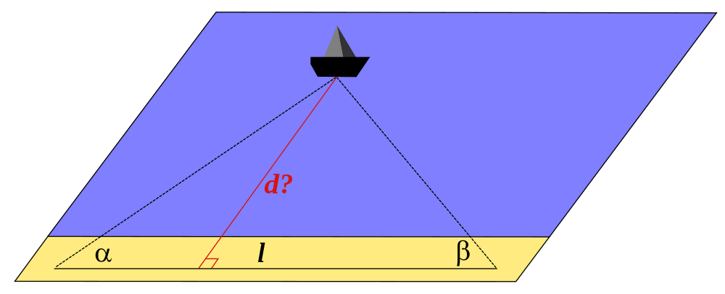
Triangulation

Slide 13
Triangulation
in robotics the problem often appears as something like:
  suppose the robot has a (calibrated) camera that detects two landmarks (with known location)
    then we can determine the angular separation, or relative bearing, α between the two landmarks
known
position
D₁
known
position
Z₁
Z₂
α
unknown
position

Slide 14
Triangulation
the unknown position must lie somewhere on a circle arc
  Euclid proved that any point on the shown circular arc forms an inscribed triangle with angle α
    we need at least one more beacon to estimate the robot’s location
known
position
D₁
known
position
α
α

